Slide 1


Using SVG’s in Power BI
Jese Navaranjan

Slide 2
Questions before we start
Do you know what a SVG image file is?
Yes/No
Do you use DAX?
Yes/No
Have you used SVG’s in your reports?
Yes/No

Slide 3
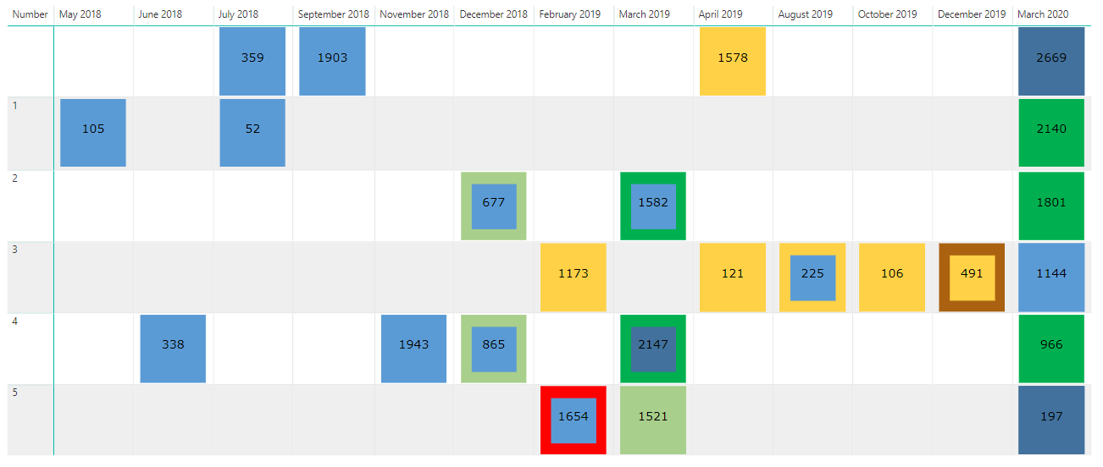
Why SVG’s?

Slide 4
Inspiration
David Eldersveld who has a 3-part blog on using SVG’s in Power BI talking about introducing SVG’s and use of Inkscape: https://dataveld.com/2018/01/13/use-svg-images-in-power-bi-part-1/
Kasper de Jonge who has this blog about KPI’s: https://www.kasperonbi.com/showing-kpis-in-a-table-or-matrix-with-power-bi/
Brian Grant on sparklines: https://www.csgpro.com/blog/2018/08/building-basic-svg-sparkline-small-multiples-measures-in-dax

Slide 5
Contents and Useful Links
What is an SVG?
What is Inkscape?
How to change colours of SVG Images in Power BI
How we can create trends and images to use in Tables and Matrix visuals
How to create trend lines in Power BI
How to create custom images using Inkscape and then applying data driven DAX Calculations to bring the images to life
Icon Libraries:
https://icomoon.io/app/#/select
Inkscape is professional quality vector graphics software which runs on Linux, Mac OS X and Windows desktop computers.
https://inkscape.org

Slide 6
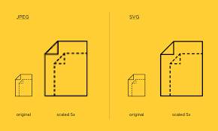
1.What’s an SVG?
SVG is a vector graphic format—based on XML and is used to display a variety of graphics on the Web and other environments.
Under the hood, SVG documents are nothing more than simple plain text files that describe lines, curves, shapes, colors, and text.
As it is human-readable, easily understood and modified.
Notes:
Reference:https://www.sitepoint.com/svg-101-what-is-svg/

Slide 7
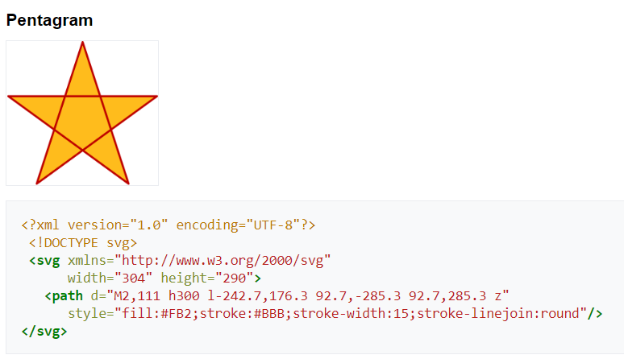
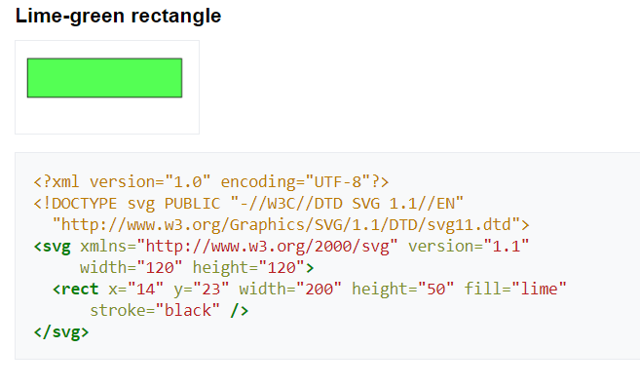
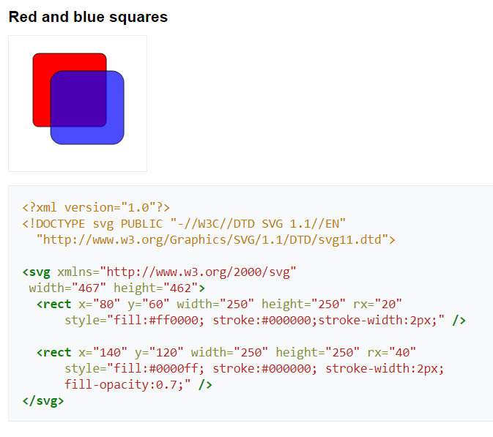
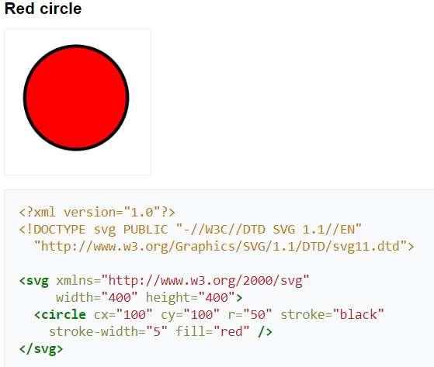
1a.Example SVG’s
Notes:
Utf8 encoded image so that the computer can decode it

Slide 8
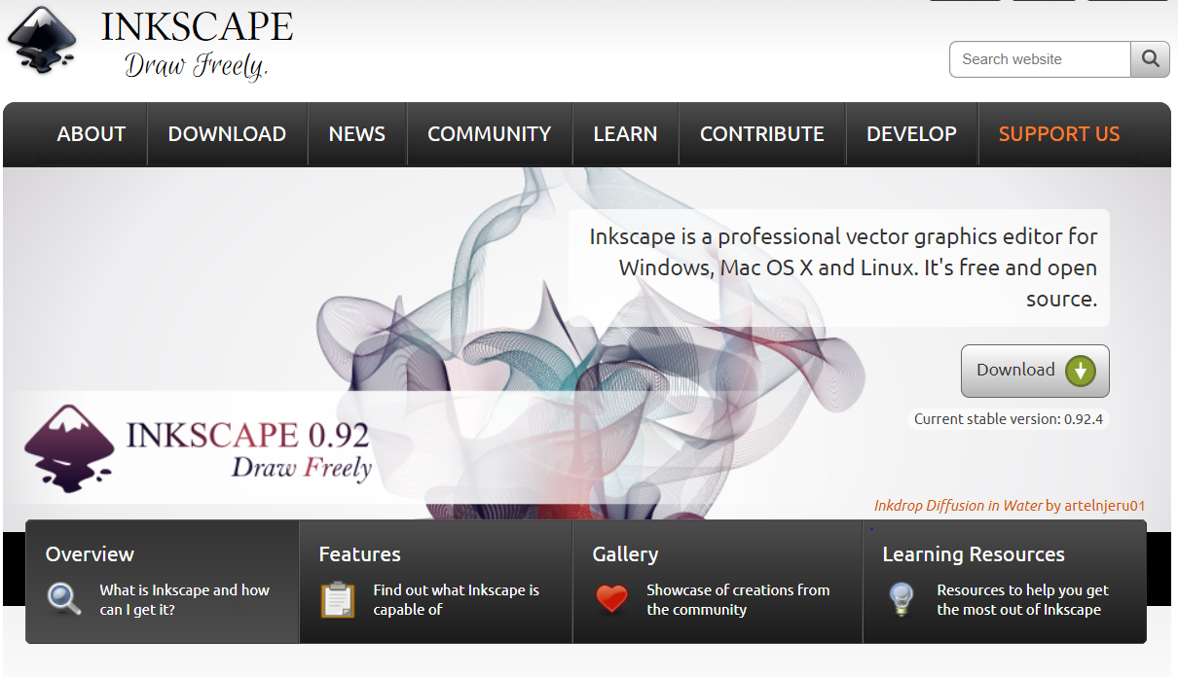
2.What is Inkscape?
Icon Libraries are a good way to get some icons to start with
https://icomoon.io/app/#/select
Inkscape is professional quality vector graphics software which can then be used to view the SVG XML Content
https://inkscape.org/

Slide 9
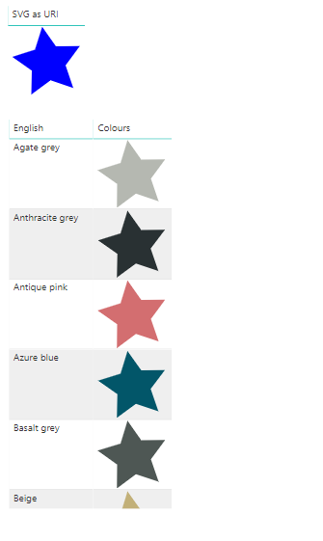
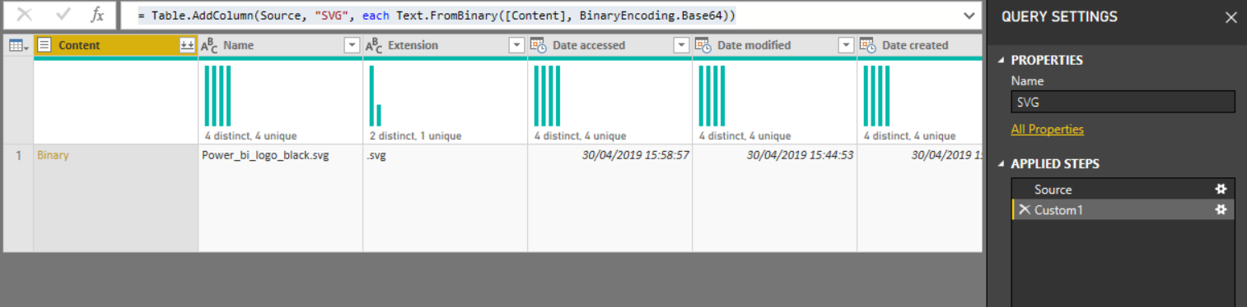
3.Colours of SVg Images
= Table.AddColumn(#"Filtered Rows", "SVG", each Text.FromBinary([Content], BinaryEncoding.Base64))
SVG as URI = "data:image/svg+xml;utf8," & Star[SVG]
Colours = SUBSTITUTE("data:image/svg+xml;utf8,"&HEXColours_Star[SVG],"#0000ff",HEXColours_Star[ HEX])

Slide 10
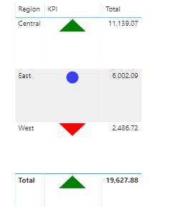
4.KPI Indicators
KPI =
VAR Radius = 9
VAR Colour = "blue"
VAR Opacity = 0.75
VAR SVG_Neutral = "data:image/svg+xml;utf8,"
& "<svg xmlns='http://www.w3.org/2000/svg' x='0px' y='0px' width='50' height='20'>"
& "<circle cx='25' cy='10' r='"
& Radius
& "' fill='"
& Colour
& "' fill-opacity='"
& Opacity
& "' />"
& "</svg>"
VAR SVG_UP = "data:image/svg+xml;utf8,"
& "<svg xmlns='http://www.w3.org/2000/svg' x='0px' y='0px' width='50' height='20'>"
& "<polygon points=""05,20 45,20 25,1"" style=""fill:green;stroke:green;stroke-width:0;fill-rule:evenodd;"" />"
& "</svg>"
VAR SVG_DN = "data:image/svg+xml;utf8,"
& "<svg xmlns='http://www.w3.org/2000/svg' x='0px' y='0px' width='50' height='20'>"
& "<polygon points=""05,1 45,1 25,20"" style=""fill:red;stroke:red;stroke-width:0;fill-rule:evenodd;"" />"
& "</svg>"
RETURN
SWITCH (
TRUE (),
SUM ( SalesData_KPI[Total] ) > 7000, SVG_UP,
SUM ( SalesData_KPI[Total]) < 2500, SVG_DN,
SVG_Neutral
)

Slide 11
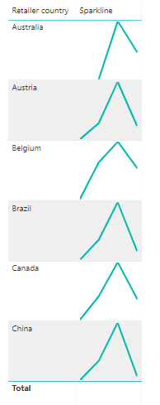
5.Trend LINes
Sparkline =
// Static line colour
VAR LineColor = "%2301B8AA"
// "Date" field used in this example along the X axis
VAR XMinDate = MIN(SalesData_Sparkline[Year])
VAR XMaxDate = MAX(SalesData_Sparkline[Year])
// Obtain overall min and overall max measure values when evaluated for each date
VAR YMinValue = MINX(VALUES(SalesData_Sparkline[Year]),CALCULATE([SUM]))
VAR YMaxValue = MAXX(VALUES(SalesData_Sparkline[Year]),CALCULATE([SUM]))
// Build table of X & Y coordinates and fit to 100 x 100 viewbox
VAR SparklineTable = ADDCOLUMNS(
SUMMARIZE(SalesData_Sparkline,SalesData_Sparkline[Year]),
"X",INT(100 * DIVIDE(SalesData_Sparkline[Year] - XMinDate, XMaxDate - XMinDate)),
"Y",INT(100 * DIVIDE([SUM] - YMinValue,YMaxValue - YMinValue)))
// Concatenate X & Y coordinates to build the sparkline
VAR Lines = CONCATENATEX(SparklineTable,[X] & "," & 100-[Y]," ", [Year])
// Add to SVG, and verify Data Category is set to Image URL for this measure
VAR SVGImageURL = IF(HASONEVALUE(SalesData_Sparkline[Retailer country]),
"data:image/svg+xml;utf8," &
"<svg xmlns='http://www.w3.org/2000/svg' x='0px' y='0px' viewBox='0 0 100 100'>" &
"<polyline fill='none' stroke='" & LineColor &
"' stroke-width='3' points='" & Lines &
"'/></svg>",
BLANK())
RETURN SVGImageURL
This sets the colour of the trend line
This sets the minimum and maximum for the x axis – which for this example is our year field)
This calculates the maximum and minimum for our y axis, namely the sum of our sales total which will determine the size of the y axis
This maps the x and y and spreads them across a 100 by 100 grid therefore representing the shape of the data
This creates the SVG image from the variables set above

Slide 12
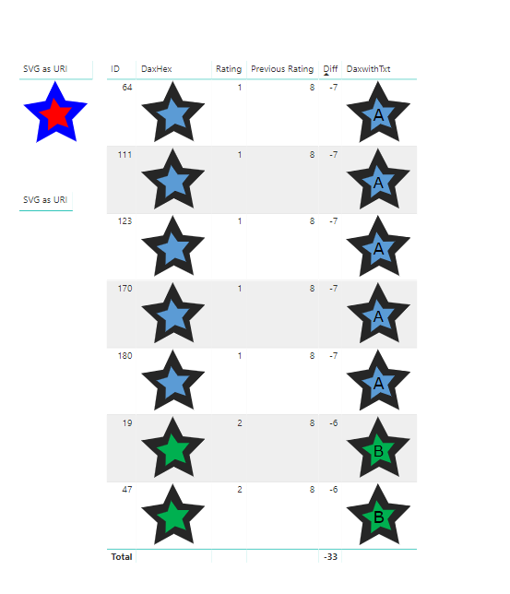
6. Custom Images
This does two substitutes based on the colours chosen by the ratings
DaxHex = "data:image/svg+xml;utf8," & SUBSTITUTE(SUBSTITUTE(RatingsData_StarCustom[StarCustom],"#ff6600",RatingsData_StarCustom[PreviousHEX]),"#0000ff",RatingsData_StarCustom[HEXCurrent])
DaxwithTxt = SUBSTITUTE(RatingsData_StarCustom[DaxHex], "</svg>","<text x='50%' y='65%' text-anchor='middle' font-family = 'Verdana' font-size='44px' fill='#000000'>" & RatingsData_StarCustom[PreviousText] & "</text></svg>")
This adds text to the rating star

